Slide 1

Predicting Movie Revenue
with Machine Learning Methods
using TMDB dataset
JIANG YUXIN -
ZHANG CHI -
ZHANG MENGAO -
FS6 - Group 2

Slide 2

Introduction
Problem
What makes a successful film? What movies make the most money at the box office?
Objective
To develop a computational model for predicting movie revenues based on genre, popularity and other influencing factors
Dataset
Extracted using the TMDB API

Slide 3
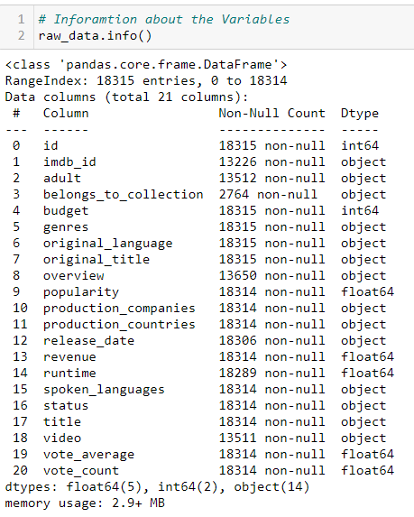
Data Preparation
Data cleaning
About the dataset
Remove duplicate rows ⇒ Data dims (13529, 21)
Drop useless columns ⇒ Data dims (13529, 11)
id, belongs_to_collection, overview, title ...
Drop rows which contain inappropriate values ⇒ Data dims (5254, 10)
zero values in the budget, revenue and runtime
Post Production for the status columns
Change column format
Genres, Production_Companies: Parse json to string
Realease_Date: Change string to Datetime
Extract year and month of release date and Put into new columns ⇒ Data dims (5254, 11)

Slide 4
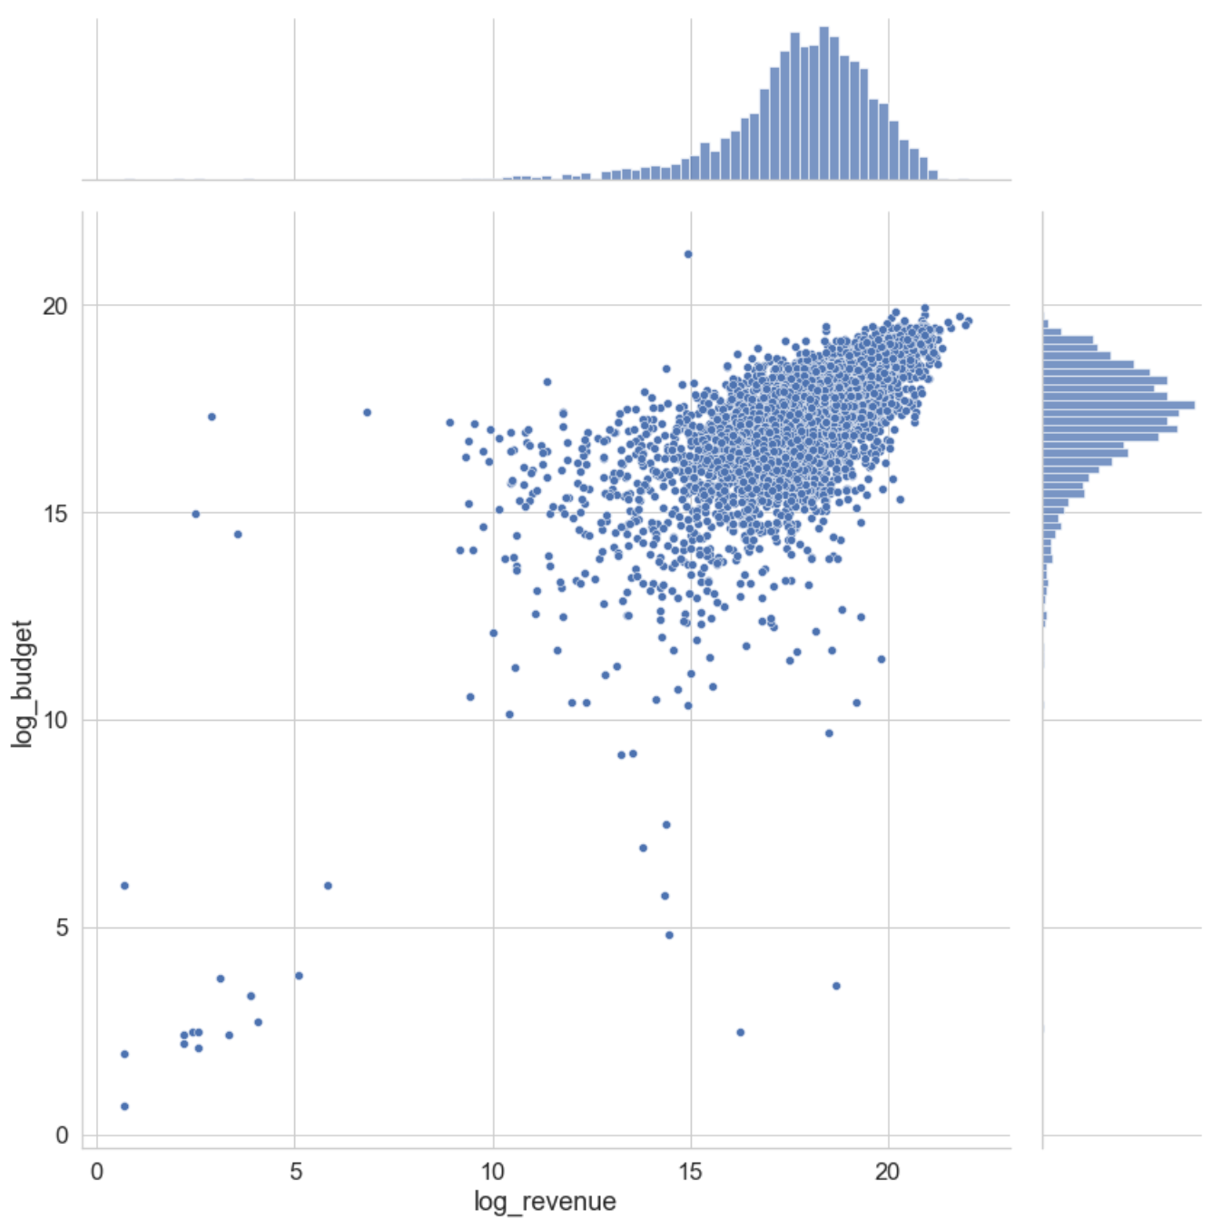
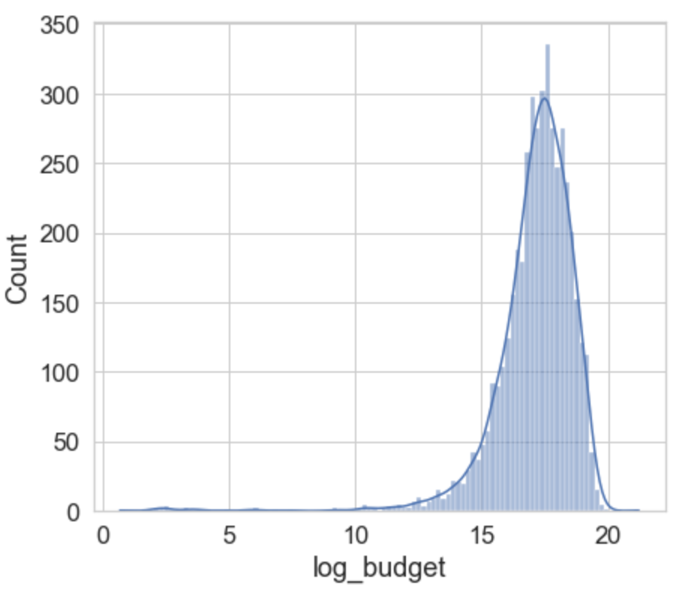
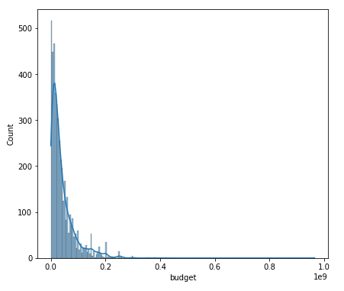
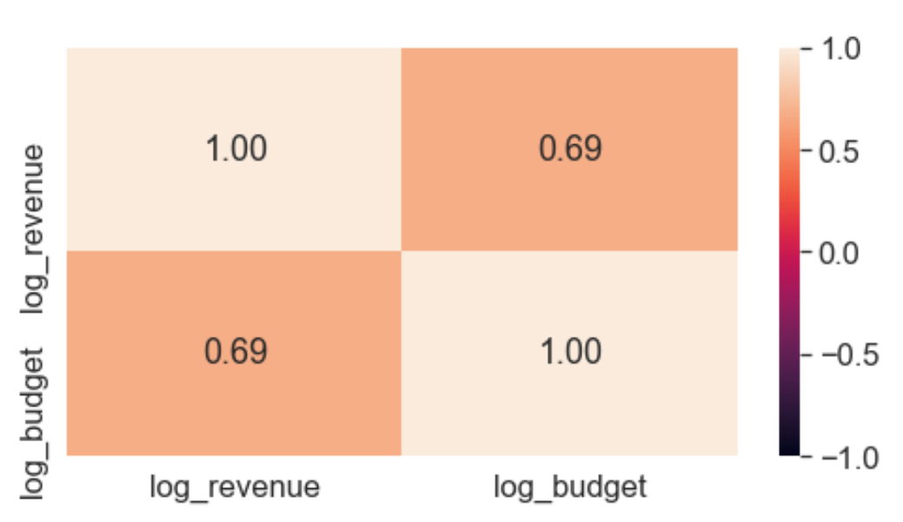
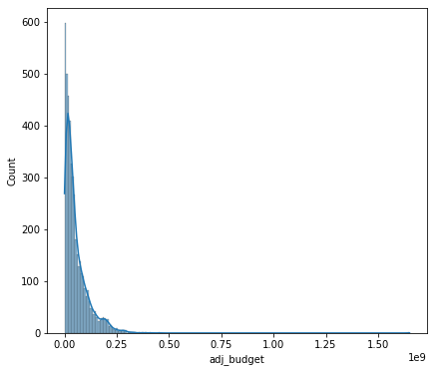
Exploration Data Analysis & Feature Engineering
Revenue & Budget
Adjust the revenue according to inflation
Highly right-skewed
=> log transformation

Slide 5
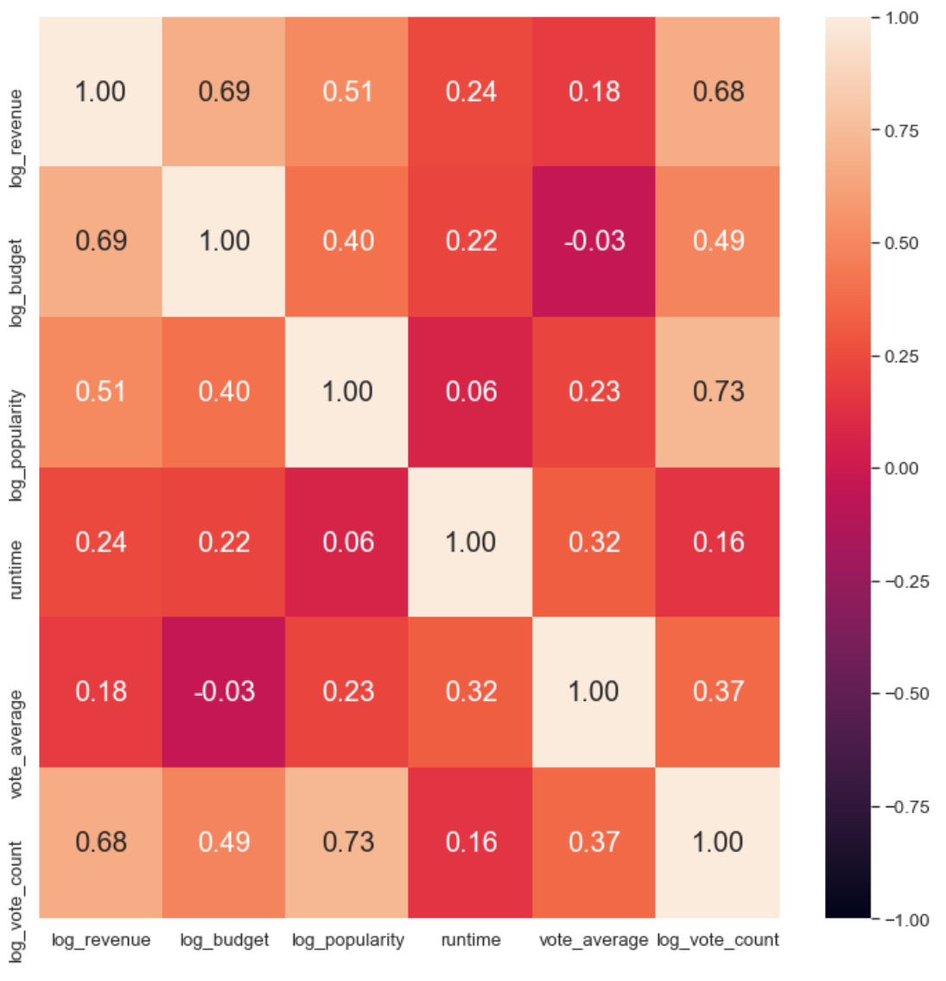
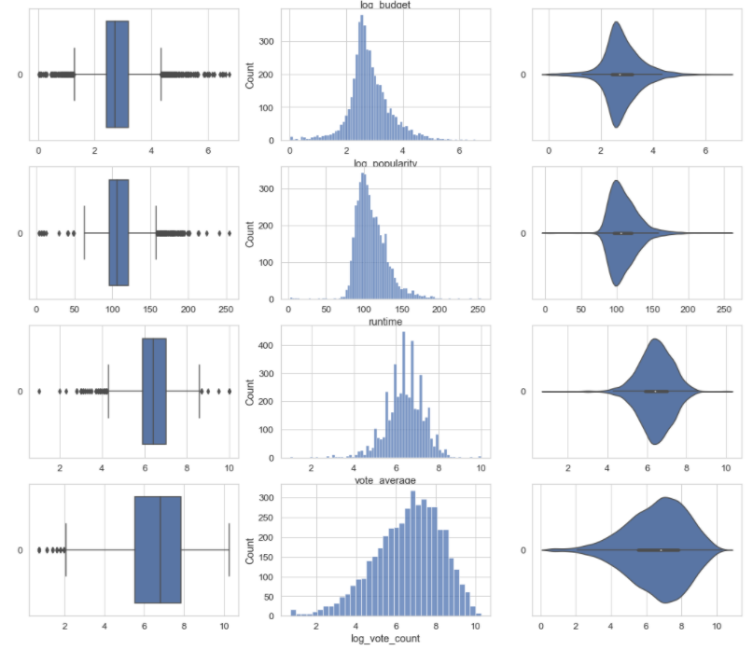
Exploration Data Analysis & Feature Engineering
Other Numeric Variables

Slide 6
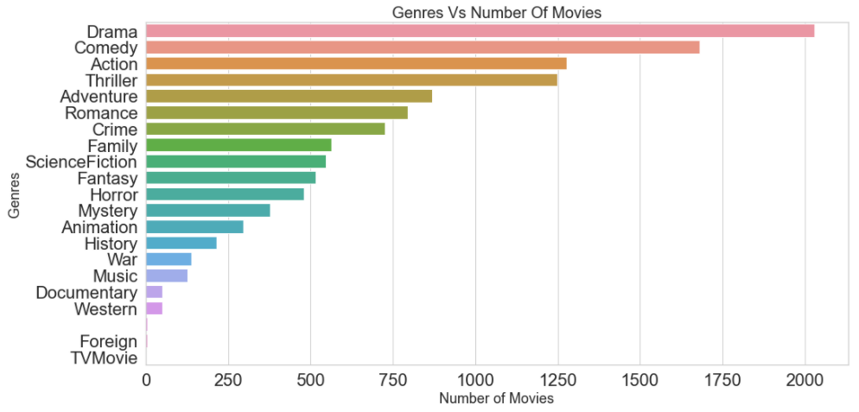
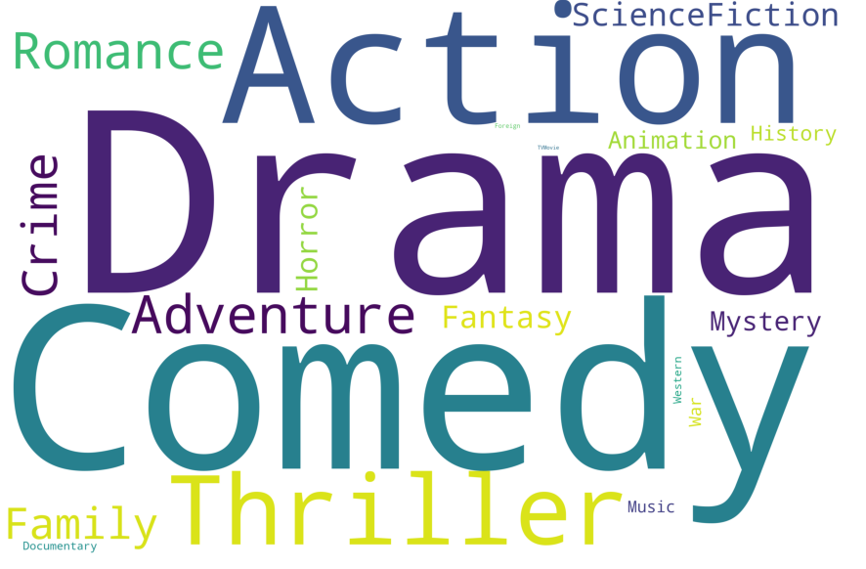
Exploration Data Analysis & Feature Engineering
Genres Total 21 unique genres
Drama is the most popular genre, followed by Comedy, Action and Thriller.

Slide 7
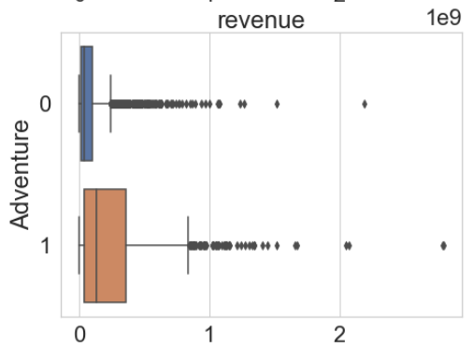
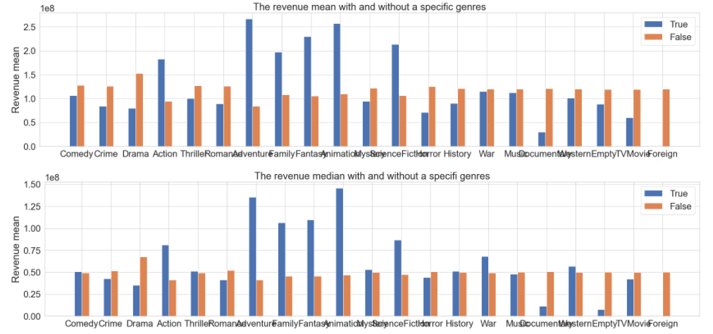
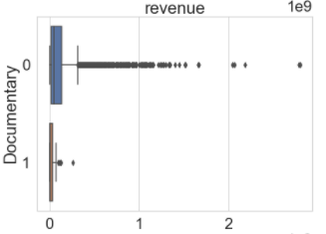
Exploration Data Analysis & Feature Engineering
Genres vs Revenue
Does the movie genres affect revenue?

Slide 8
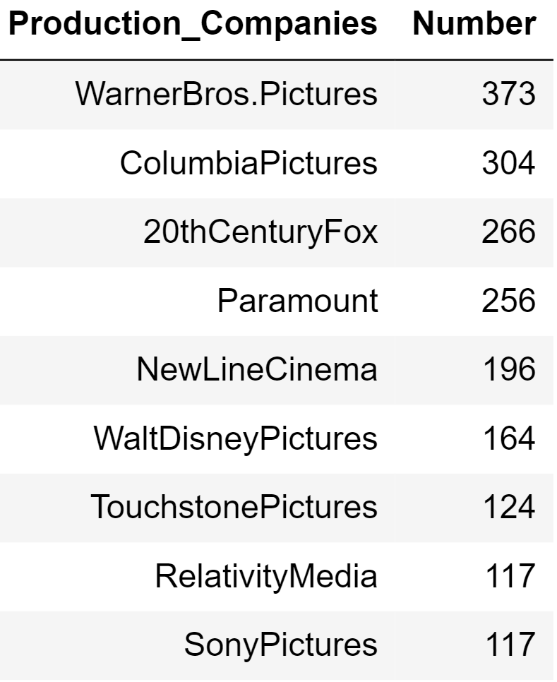
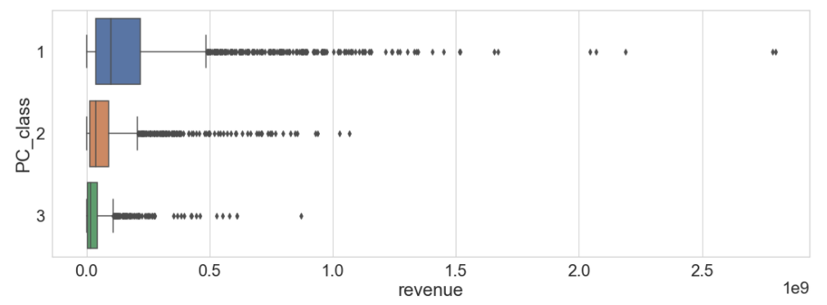
Exploration Data Analysis & Feature Engineering
Production_company
Divide production companies into three classes according to the number of movies they produced

Slide 9
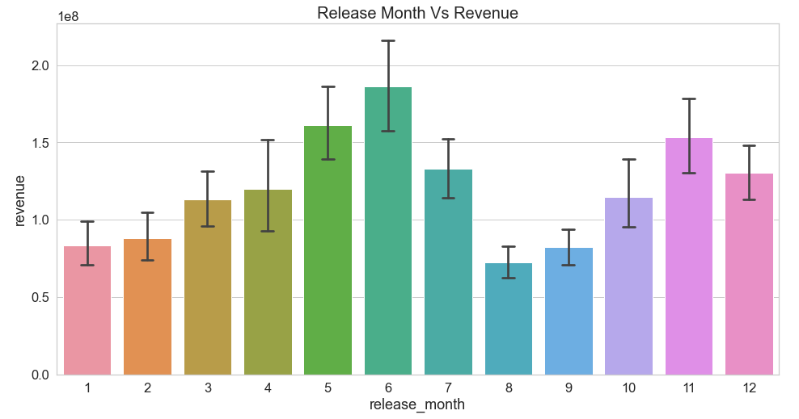
Exploration Data Analysis & Feature Engineering
Release_month
Summer Vacation
May - Jun
Christmas
Nov - Dec

Slide 10
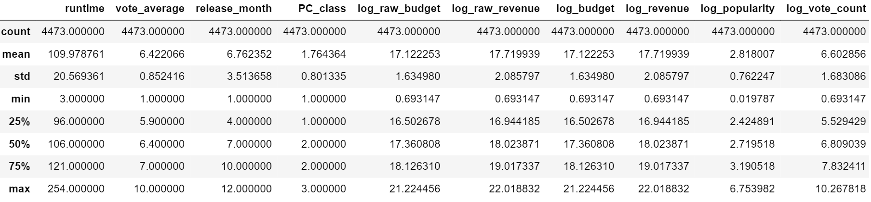
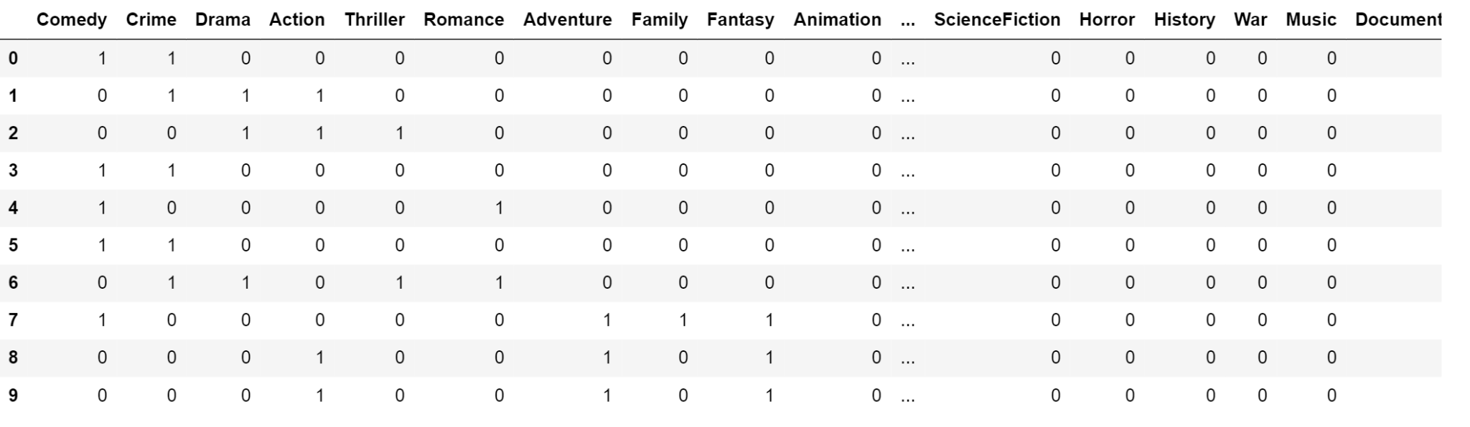
Exploration Data Analysis & Feature Engineering
Dataset ready to build model
(4473 rows, 31 columns)
One hot encode

Slide 11
Machine Learning --- Regression
Assumption: 1. i.i.d normal distribution of error terms
2. linear relationship
Linear Regression → Simple, low time complexity
Ridge Regression
Regularization: add a constraint to the loss function
LASSO Regression

Slide 12
Machine Learning --- Regression
 | MSE | R square
Linear regression | 1.50562740505947 | 0.6636029199484988
Ridge regression | 1.5050298144608574 | 0.663736437531776
LASSO regression | 2.16446512339398 | 0.5164011063186729
→ Linear regression model performs best
Reason: not much multicollinearity

Slide 13
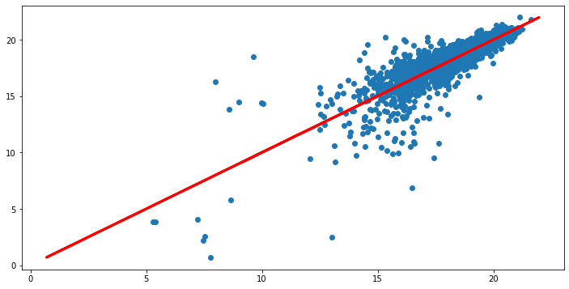
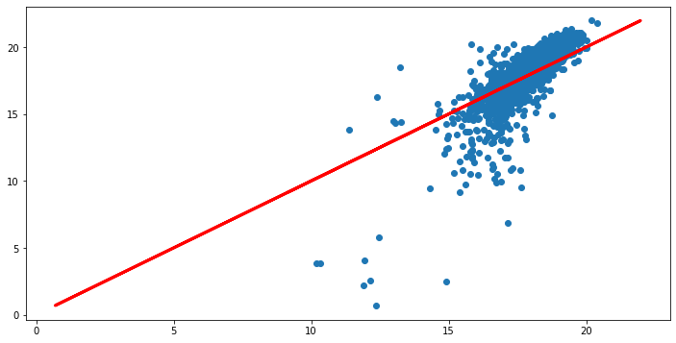
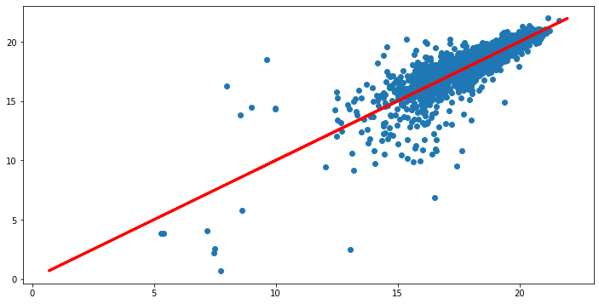
X: Actual
Y: Predicted
Linear regression
LASSO regression
Ridge regression

Slide 14
Machine learning- decision tree
Purpose of using decision tree:
To capture any possible relationship both, linear and non-linear, between the data
Regression Tree:
Simplest way to predict the value
Easily overfit
Random Forest:
Reduces overfitting
Handle biased data well
Fully consider every variables

Slide 15
Machine learning- decision tree
(Adjusted) | MSE | R square
Regression tree | 1.4334670897300783 | 0.63433758341579
Random forest | 1.2825144779031699 | 0.6856055065919986
Random forest: best performance among the models

Slide 16
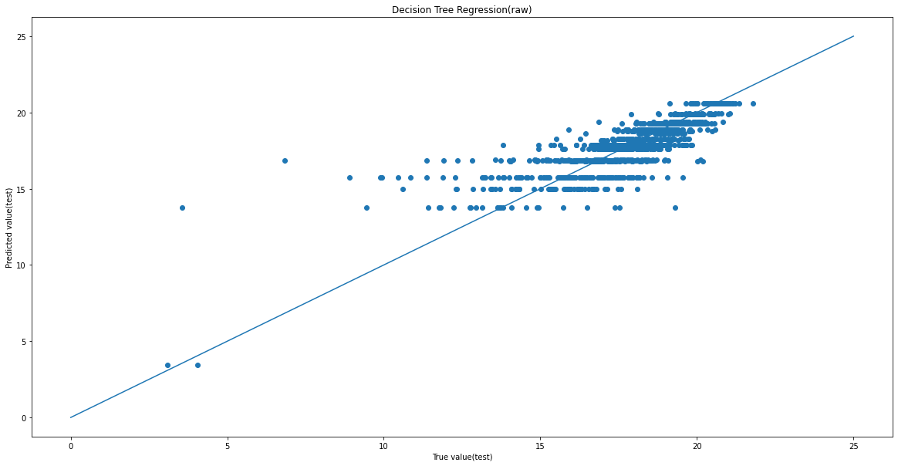
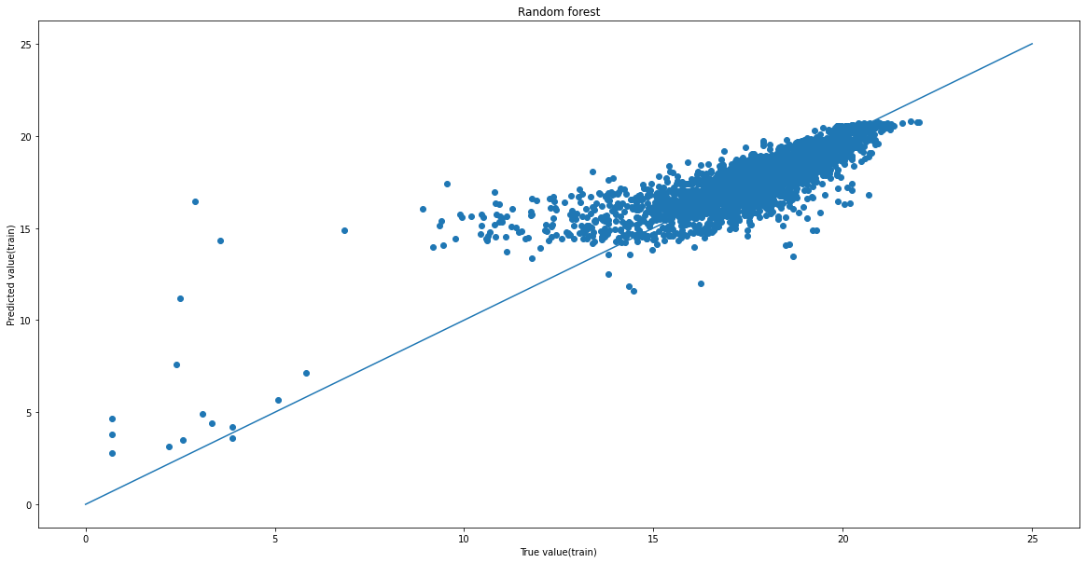
Machine learning- decision tree
X: Actual Y:Predicted
Regression tree
Random Forest

Slide 17
Linear Regression | MSE | R square
Raw data | 1.5082409483318104 | 0.6342647270003762
Data with inflation in mind | 1.50562740505947 | 0.6636029199484988
↑ by 0.03
Random Forest | MSE | R square
Raw data | 1.2825144779031699 | 0.6348449716226254
Data with inflation in mind | 1.3353476522971441 | 0.6856055065919986
↑ by 0.051
Important to consider inflation

Slide 18
Outcome & Data-driven Insights
Outcome: Aquire a prediction model with 0.68 R² value
Revenue Prediction HTML webpage
Insights:
Higher budget & Higher vote count → Higher revenue
Release in May, Jun, and Nov → Higher revenue
Inflation plays an important role

Slide 19
Potential Improvement
Consider cast, directors, overview, and other factors
Group production companies in a better way
Do a PCA or LDA to eliminate uncorrelated genre variables
Explore more models (e.g. XGBoost, Neural Network)

Slide 20
New Tools and Techniques Learnt
Data crawling via API
Pandas Profiling
Genrate interactive HTML report of first-level EDA
WordCloud
Visual representations of words
Categorical data
One-hot encode, Combine level
Prediction models
Regression Tree, Random Forest, Ridge Regression, LASSO Regression
HTML, Javascript

Slide 21
Contribution
Data Acquisition - ZHANG CHI, JIANG YUXIN
Data Cleaning - JIANG YUXIN
Feature Engineering - JIANG YUXIN, ZHANG MENGAO
Exploratary Data Analysis - JIANG YUXIN, ZHANG MENGAO
Machine Learing - ZHANG MENGAO, ZHANG CHI
Interactional Prediction Tool - ZHANG CHI

Slide 22
External Sources
Inflation rate retrieved from: https://smartasset.com/investing/inflation-calculator
Relative programing language learn from:
https://www.w3schools.com
https://stackoverflow.com/

Slide 23



JIANG YUXIN -
FS6 - Group 2
THANK YOU
ZHANG MENGAO -
ZHANG CHI -

